Slide 1
Alerts and Tasks
Emanuele Della Valle
Prof. @ Politecnico di Milano
Founder & Partner @ Quantia Consulting
Marco Balduini
Founder & CEO @ Quantia Consulting
Riccardo Tommasini
Prof. @ University of Tartu

Slide 2
Alerts

Slide 3
Data-driven decision
Descriptive
What happen?
Diagnostic
Why did it happen?
historical
analysis
Predictive
What will happen?
Data
Decision
Action
Decision Support
reactive decisions
Prescriptive
What should I do?
Decision Automation
[src. Gartner]
Machine-centered
Human-Centered

Slide 4
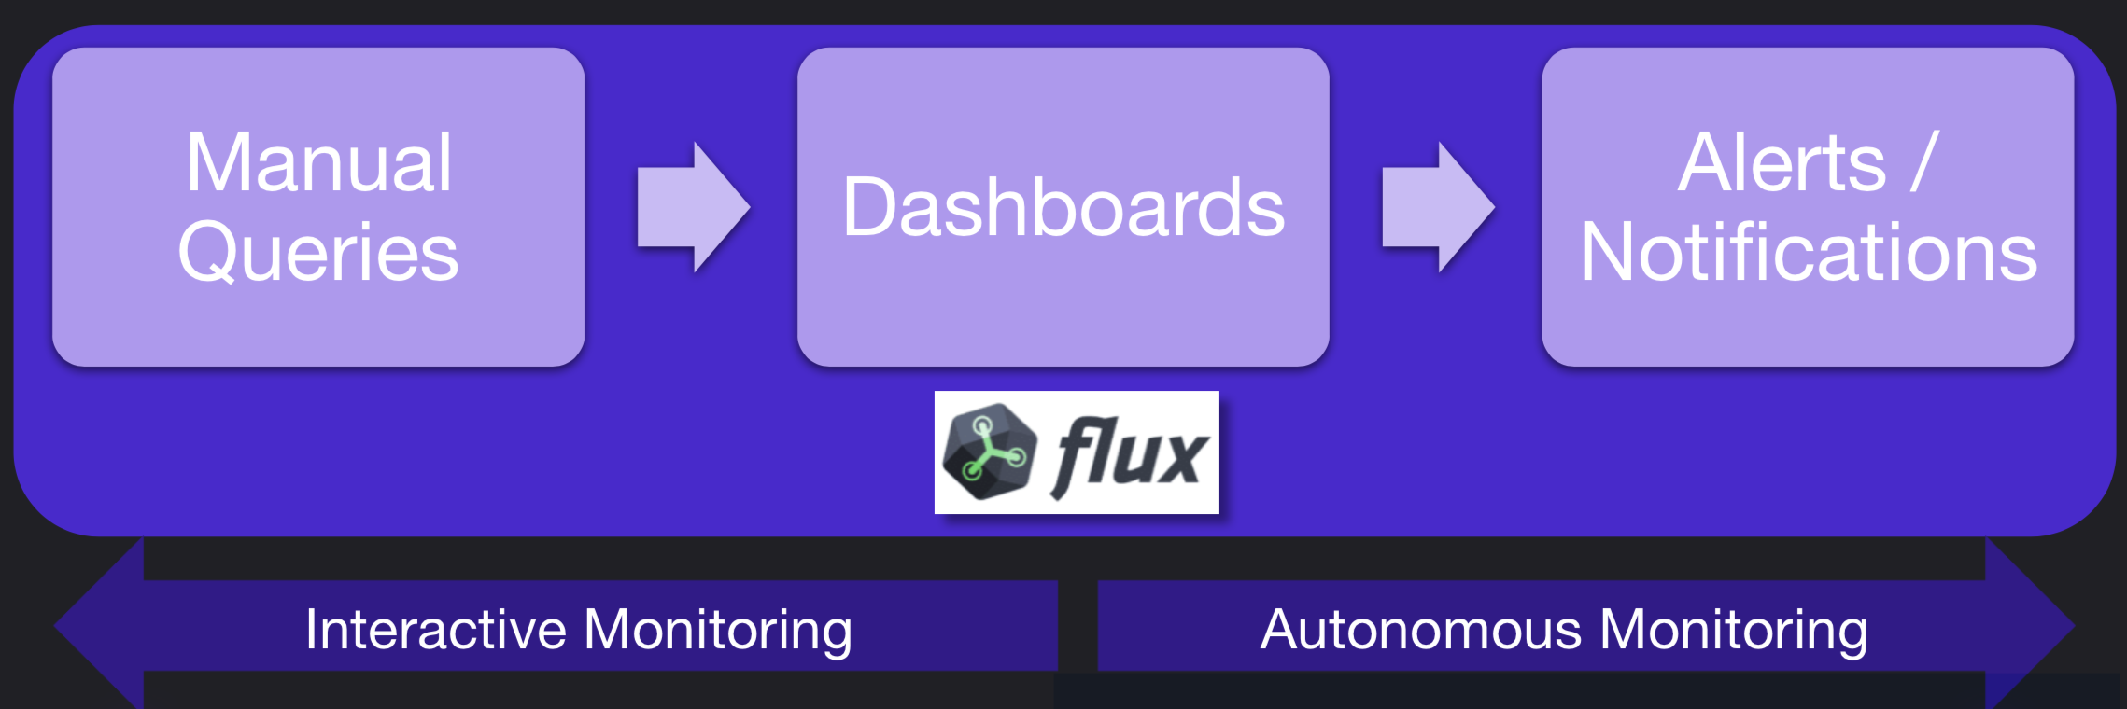
Interactive vs. Autonomous Monitoring

Slide 5
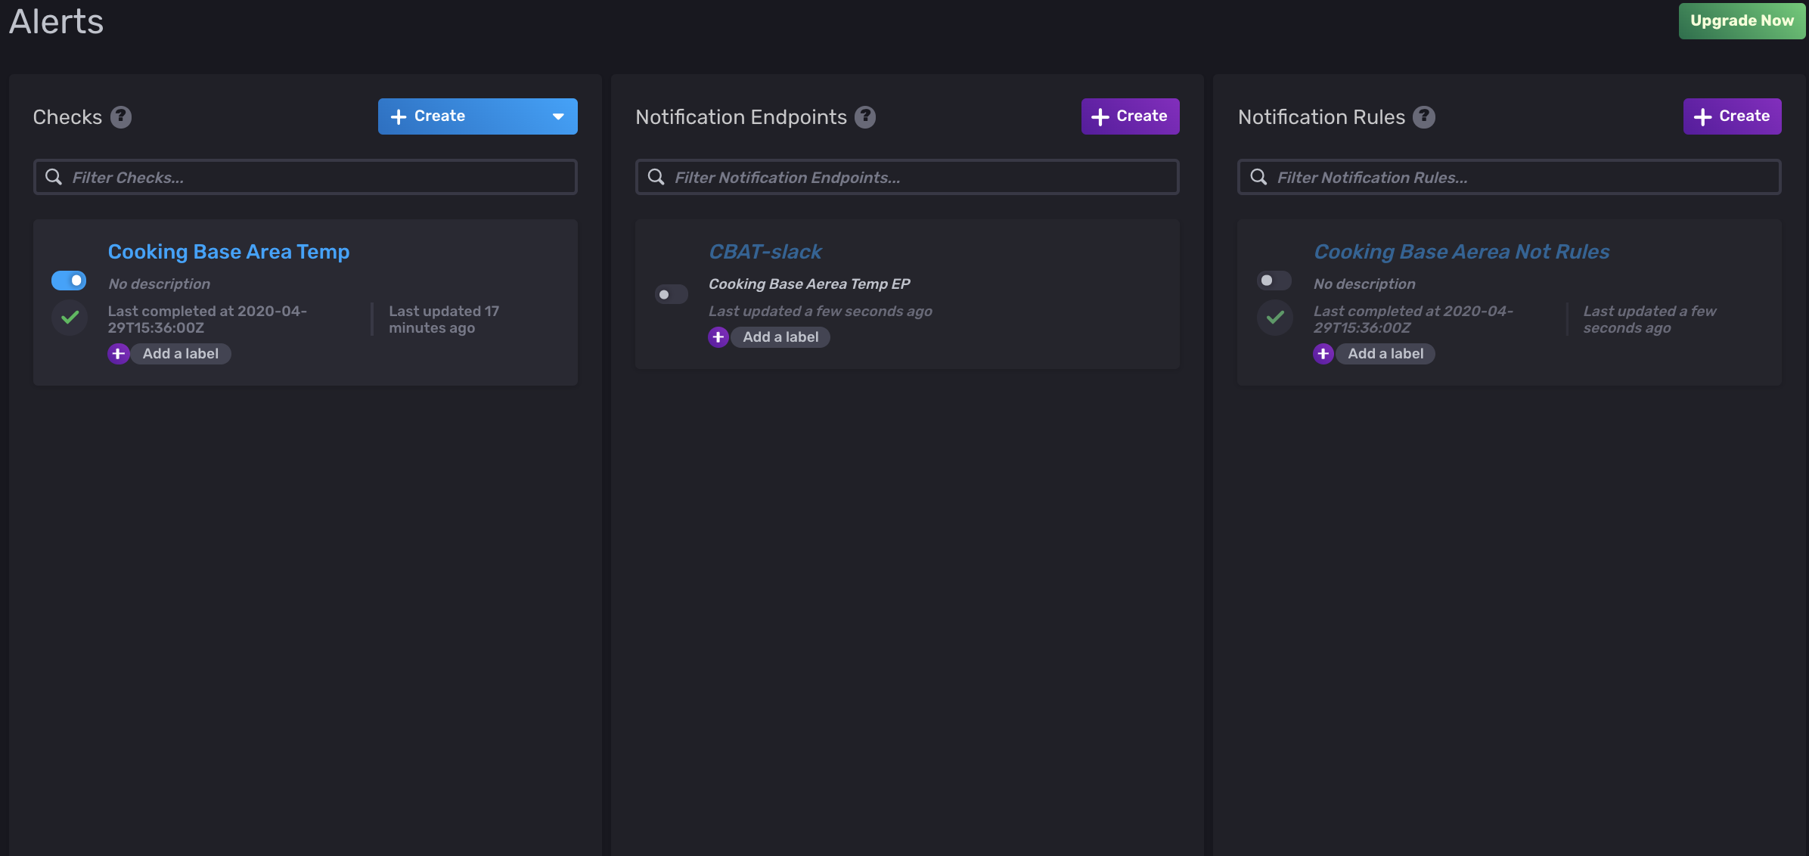
Alerts
Types of Alerts
Threshold
Deadman
Alerts are defined as
a base query
threshold criteria
condition mapping
notifications

Slide 6
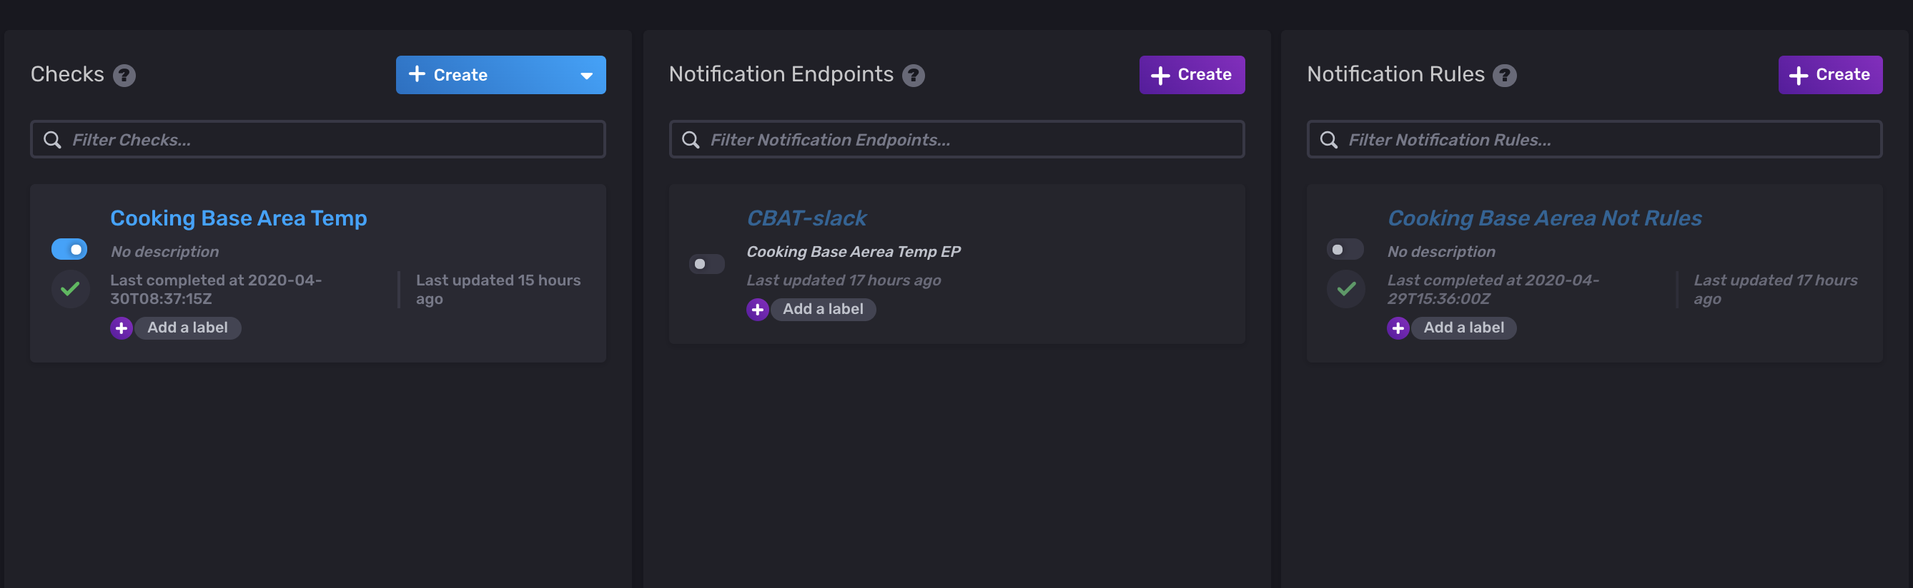
Alerts UI

Slide 7
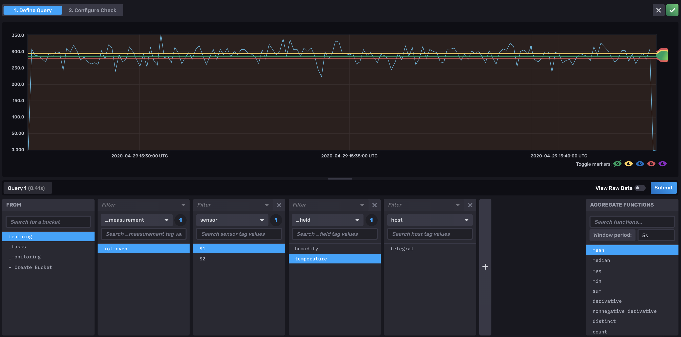
Alerts UI – check view – query pane
base query

Slide 8
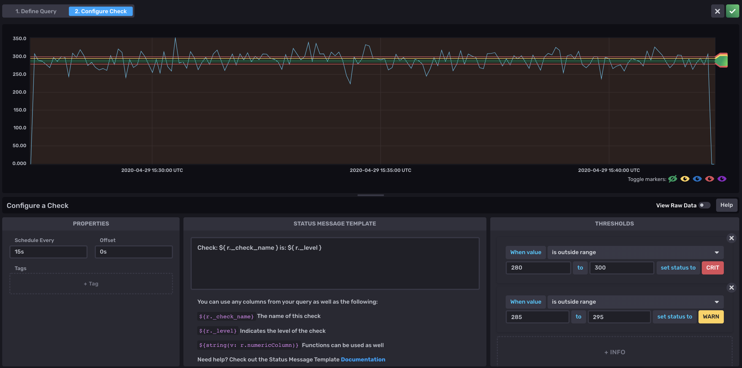
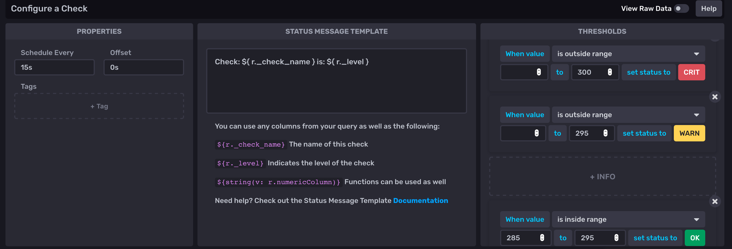
Alerts UI – check view – check pane
critic condition threshold
warn condition threshold
threshold criteria
condition mapping

Slide 9
Notifications
Possibility to define
Notification endpoints on a Slack channel
Notification rules
When
What

Slide 10
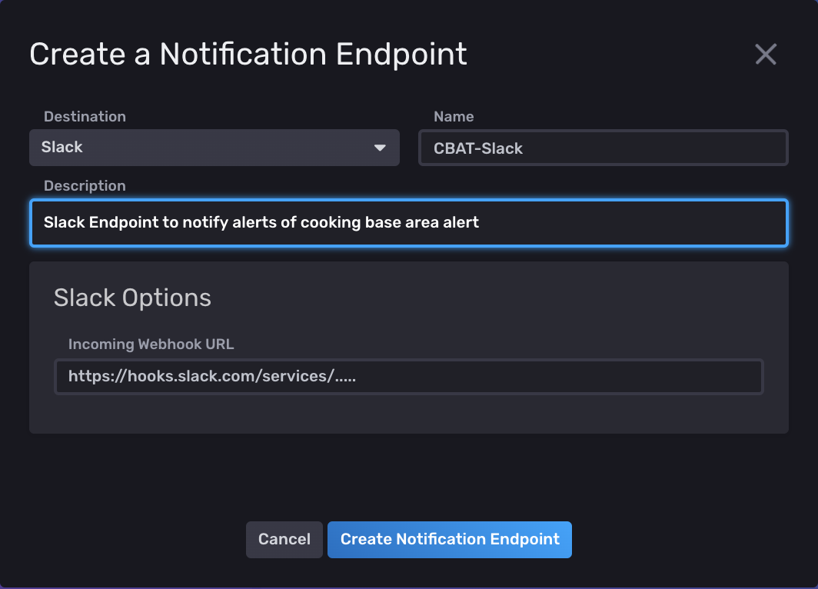
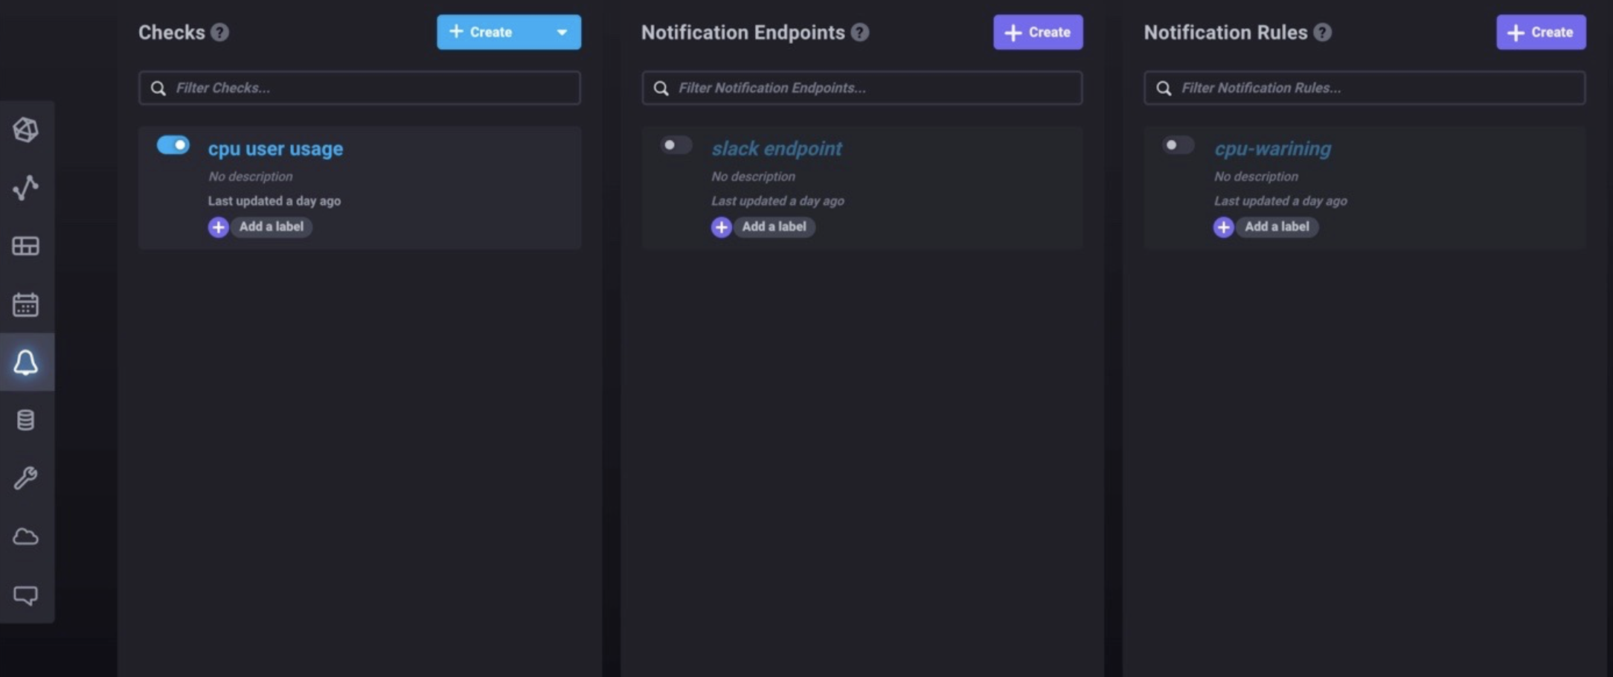
Notifications
Possibility to define
Notification endpoints on a Slack channel
Notification rules
When
What

Slide 11
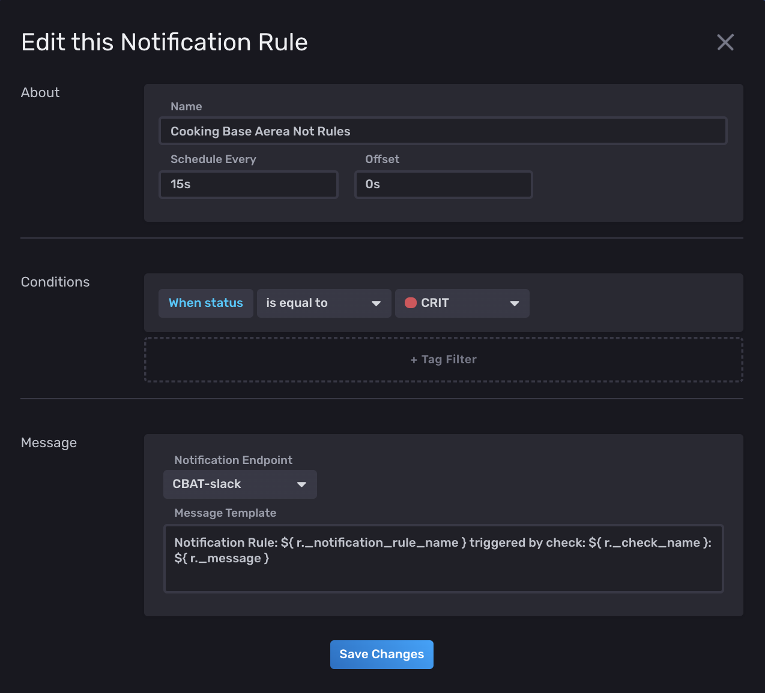
Notifications
Possibility to define
Notification endpoints on a Slack channel
Notification rules
When
What

Slide 12
Tasks

Slide 13
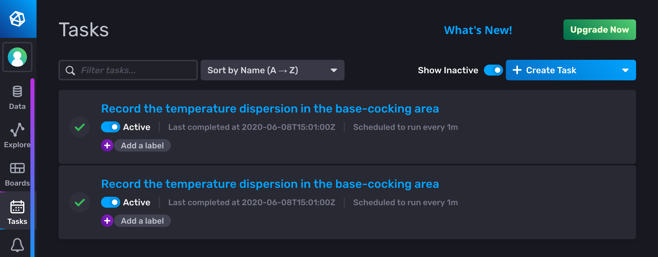
Tasks
The power of Flux for continuous processing and analysis

Slide 14
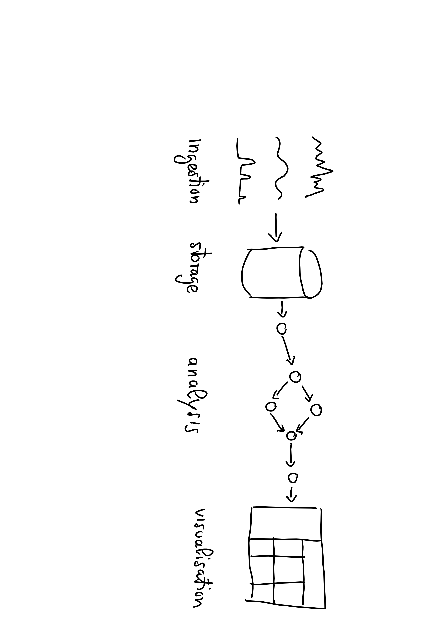
Recall the Data Lifecycle of this morning

Slide 15
Tasks continuously write back to the storage the results of the analysis

Slide 16
Writing into a bucket using to()
Syntax
to(bucket: <<name>>, org:<<organization>>)
Example
from(bucket:"foo")
|> ...
|> to(bucket: ”bar", org:”some@quantiaconsulting.com")

Slide 17
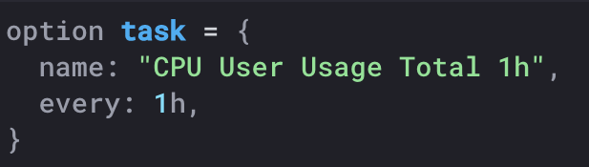
Tasks are Written in the Flux Language
No need to learn a separate language to write Tasks
No need to use separate tools for debugging Tasks
Tasks define all options within the script for portability
Options include
Name
Run Interval
every
CRON syntax
Tasks are self contained and can be imported / exported

Slide 18
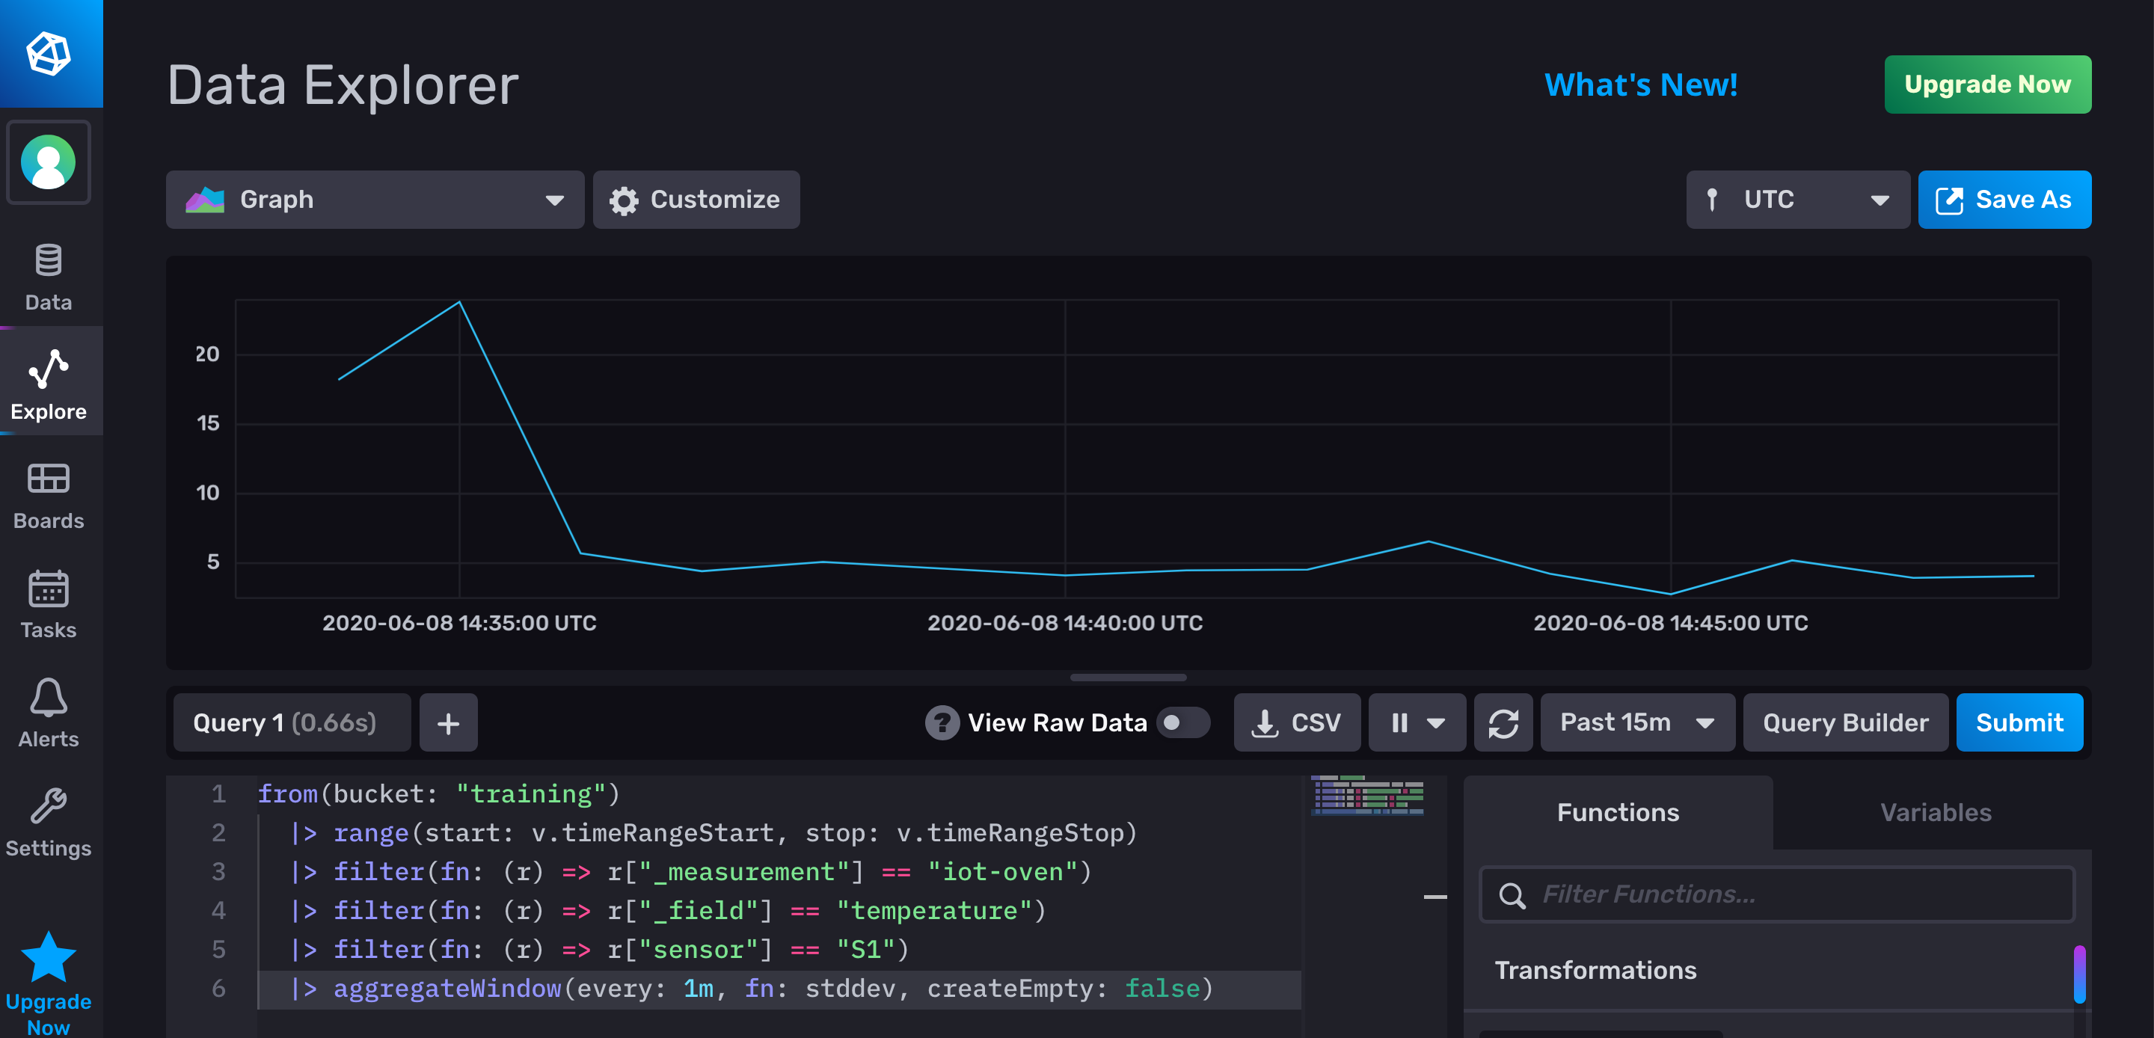
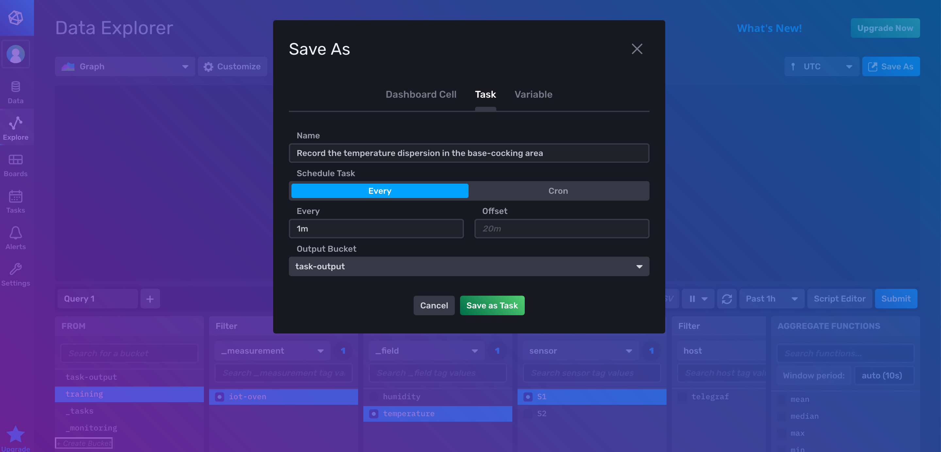
Best practice
Prepare the query in the Data Explorer
Save it as a Task

Slide 19
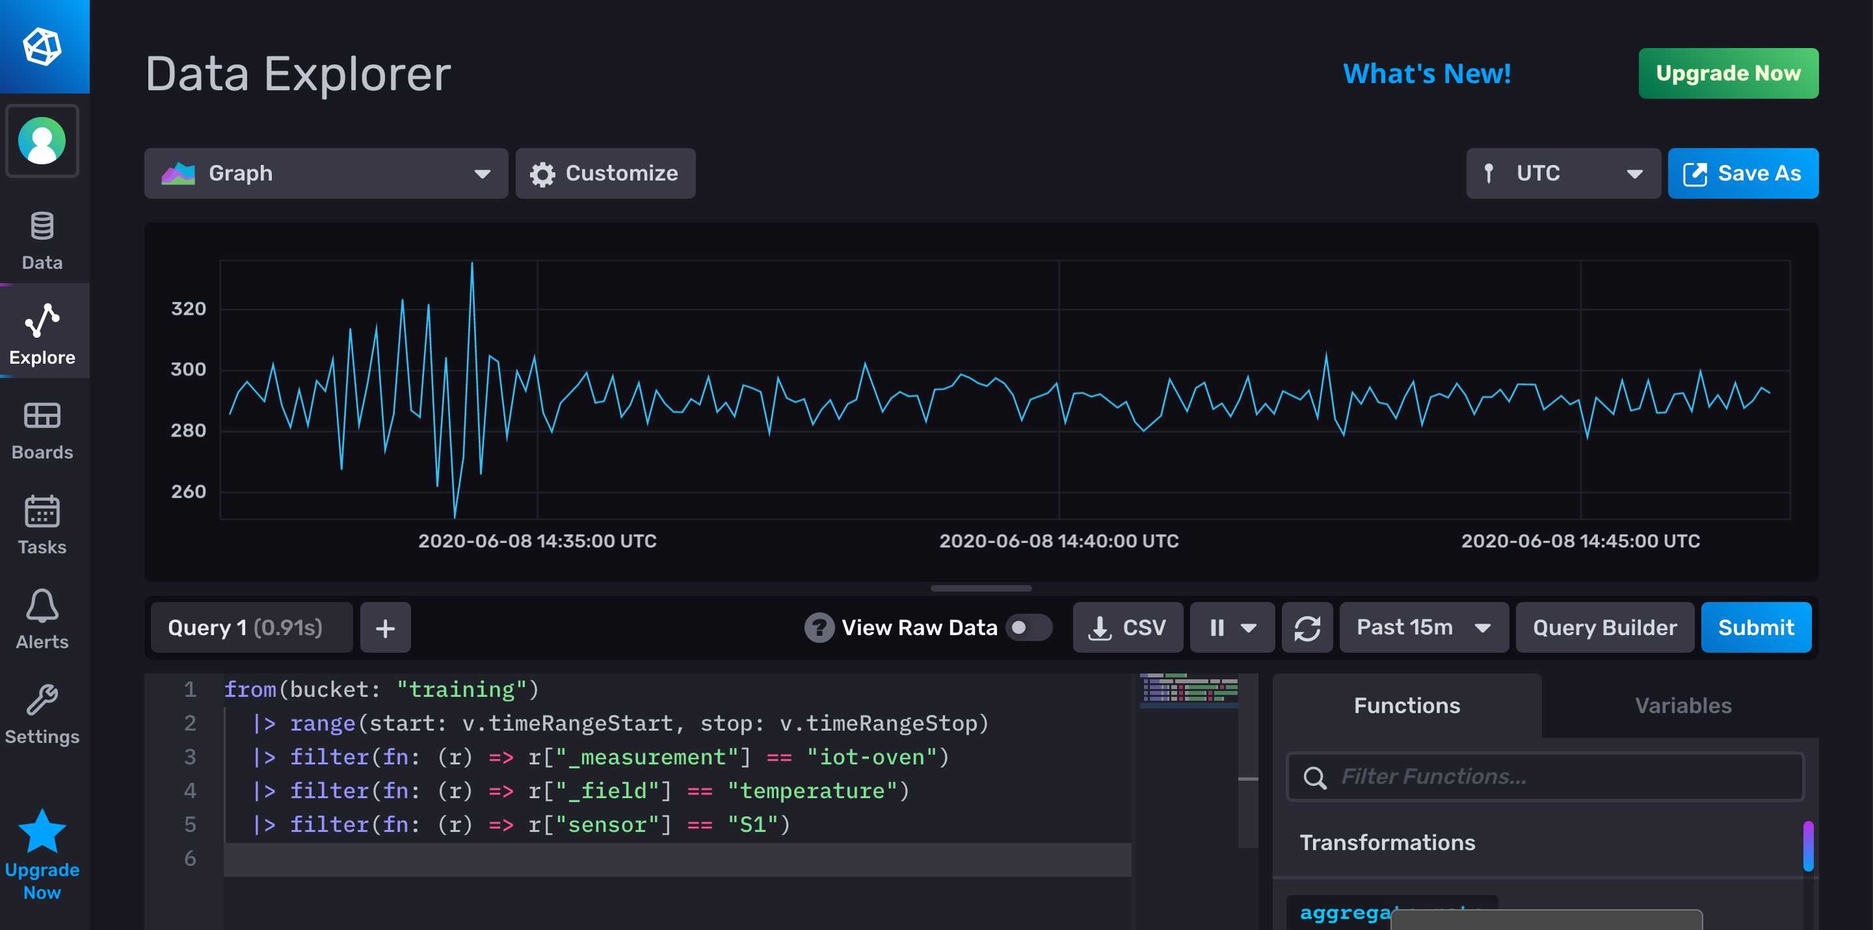
Practical example: record the temperature dispersion

Slide 20
Practical example: record the temperature dispersion

Slide 21
Practical example: record the temperature dispersion

Slide 22
Alerts and Tasks
Emanuele Della Valle Prof. @ Politecnico di Milano & Partner @ Quantia Consulting
Marco Balduini Founder & CEO @ Quantia Consulting
Riccardo Tommasini Prof. @ University of Tartu

